Slide 1

Vehicle and Pedestrian Detection Using Haar Cascade
Department of Computer Science and Engineering
Under the Guidance of
Dr. T. Srinivasa Rao, MTech, PhD
Associate Professor, Department of CSE
Ch. Keerthi Sai 18481A0545
D. Prathyusha 18481A0557
Ch. Lakshmi Pallavi 18481A0549
B. Harish Chandra 18481A0525

Slide 2
Abstract
Computer Vision Plays a vital role in traffic management and surveillance systems and has been an active research area in the past years.
In systems like these, the detection of vehicles and also classification of the vehicle plays a major role. The datasets are traffic videos of urban environment taken from various cities around the world which were used to train the classifier hence generating a robust classifier.
The proposed approach is computationally less expensive with faster processing speed. The experiments on-road prove it to be a robust and real time algorithm which is highly competitive with the existing architecture.
This System has the following Haar Cascades:
Haar Cascade for Car detection
Haar Cascade for Bus Detection
Haar Cascade for Two-Wheeler Detection
Haar Cascade for Pedestrian Detection

Slide 3
Introduction
Vision Recognition by Computer is an important part of traffic management and surveillance systems, and it's been a hot topic for research in recent years. Vehicle detection and classification play an important role in systems like this.
The datasets consist of traffic footage from several cities across the world that were used to train the classifier, resulting in a robust classifier. The proposed method is less expensive in terms of computation and has a faster processing speed.
The Haar cascade is a machine learning object detection approach that uses features given by Paul Viola and Michael Jones in their work to identify things in an image or video.
Obtaining data (pictures) from video, applying pre-processed images, categorising images into different categories, and training these images using the cascade algorithm are all part of the training-classifier stage.

Slide 4
Objectives
The objective of pedestrian detection is to detect the apparent objects in with knowledge collected from the labeled pedestrian and non-pedestrian examples.
An essential progress was made in the last decade because of its practical utilization in many computer vision applications such as video surveillance, robotics interaction.
Vehicle and Pedestrian Detection can be helpful in various aspects. Usually, they are mostly used in
Traffic Management
Surveillance Systems.

Slide 5
Existing System
The Existing System helps to detect the Pedestrians using Deep Learning Techniques.
It uses the algorithms HOG/Linear SVM. The HOG is used for Feature Extraction and Linear SVM is used for Classifier Selection.
The major drawback of the existing system are:
Speed
Resolution

Slide 6
Proposed System
The Proposed System helps to overcome the drawbacks of Speed and Resolution through Feature Extraction and Cascade Classifiers.
Haar Cascade Classifier is a Machine Learning Based Approach in which Cascade Function is trained using a sample that contains a lot of positive and negative images.
The algorithm can be explained in four stages:
Calculating Haar Features
Creating Integral Images
Using Adaboost
Implementing Cascading Classifiers
The outcome of the AdaBoost classifier is that the strong classifiers are divided into stages to form cascade classifiers which boosts the speed of training.

Slide 7
Proposed System
The cascade classifier splits the classification work into two stages:
Training.
Detection.
In order to train the cascade classifier, we need a set of positive and negative samples.
The Negative samples are collected from arbitrary images, which do not include the objects to be detected and The Positive samples includes the objects which are needed to be detected.
The classifier was trained with a few positive and negative samples, which are arbitrary images of the same size, of which both samples were equally scaled in their size. The classifier generates “1” if the region possibly identifies the face and generates “0” otherwise.

Slide 8
Methodology
Haar Cascade is basically a machine learning based approach where a cascade function is trained from a lot of images both positive and negative.
This algorithm requires a lot of positive images (i.e., objects) and negative images (i.e., non-objects) to train the classifier, similar to other machine learning models.

Slide 9
Methodology
We need to extract features from the positive and negative images. For that the Haar Features are used i.e., Edge Features, Line Features, Four-Rectangle Features.
Adaptive Boosting or AdaBoost is used to remove redundant features and choose only relevant features. These features are also called as weak classifiers.
A weak classifier alone can’t classify the object but Adaboost constructs a strong classifier as a linear combination of these weak classifiers which is capable of classifying a an object.

Slide 10
Algorithm
Haar Cascade Classifier:
It is a machine learning based approach in which a cascade function is trained from a lot of positive and negative images. It is then used to detect objects in other images.
The algorithm can be explained in four stages:
Calculating Haar Features
Creating Integral Images
Using Adaboost
Implementing Cascading Classifiers
It’s important to remember that this algorithm requires a lot of positive images and negative images of non-faces to train the classifier, similar to other machine learning models.

Slide 11
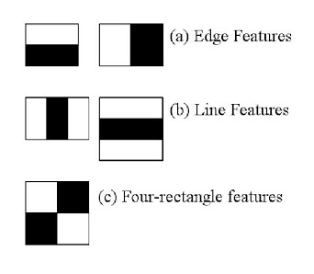
Algorithm
Calculating Haar Features:
The first step is to collect the Haar features. A Haar feature is essentially calculations that are performed on adjacent rectangular regions at a specific location in a detection window. The calculation involves summing the pixel intensities in each region and calculating the differences between the sums. Here are some examples of Haar features below.
These features can be difficult to determine for a large image. This is where integral images come into action because the number of operations is reduced using the integral image.
Fig: Haar Features

Slide 12
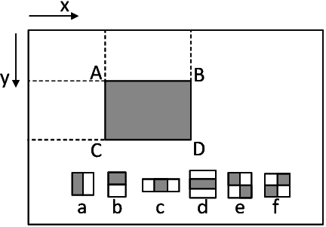
Algorithm
Creating Integral Images:
Without going into too much of the mathematics behind it, integral images essentially speed up the calculation of these Haar features. Instead of computing at every pixel, it instead creates sub-rectangles and creates array references for each of those sub-rectangles. These are then used to compute the Haar features.
It’s important to note that nearly all of the Haar features will be irrelevant when doing object detection, because the only features that are important are those of the object. However, how do we determine the best features that represent an object from the hundreds of thousands of Haar features? This is where Adaboost comes into action.
Fig: Integral Images Creation

Slide 13
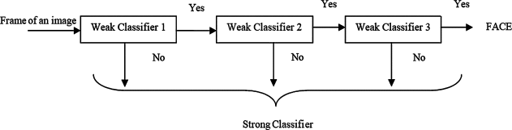
Algorithm
Adaboost Training:
Adaboost essentially chooses the best features and trains the classifiers to use them. It uses a combination of “weak classifiers” to create a “strong classifier” that the algorithm can use to detect objects.
Weak learners are created by moving a window over the input image, and computing Haar features for each subsection of the image. This difference is compared to a learned threshold that separates non-objects from objects. Because these are “weak classifiers,” a large number of Haar features is needed for accuracy to form a strong classifier
Fig: Combining Weak Classifiers

Slide 14
Algorithm
Implementing Cascading Classifiers:
The cascade classifier is made up of a series of stages, where each stage is a collection of weak learners. Weak learners are trained using boosting, which allows for a highly accurate classifier from the mean prediction of all weak learners.
Based on this prediction, the classifier either decides to indicate an object was found (positive) or move on to the next region (negative). Stages are designed to reject negative samples as fast as possible, because a majority of the windows do not contain anything of interest.
It’s important to maximize a low false negative rate, because classifying an object as a non-object will severely impair your object detection algorithm.

Slide 15
Algorithm
Pseudocode:
Let F_{target} is target overall false positive rate.
Let P is a set of positive examples.
Let N is a set of negative examples.
Let F₀=1, D₀=1 and i=0 where F₀ is overall false positive rate at layer 0, D₀ is acceptable detection rate at layer 0 and i is the current layer.
While F_{i}> F_{target} :
Increase Layer by 1
Use P and N to train with AdaBoost to make xml file.
Check the result of new classifier for F_{i} and D₀
Decrease the threshold for new classifier to adjust detection rate r>=d* F_{i-1}
N=empty
If F_{i>} F_{target} , use the current classifier and false detection to set N.

Slide 16
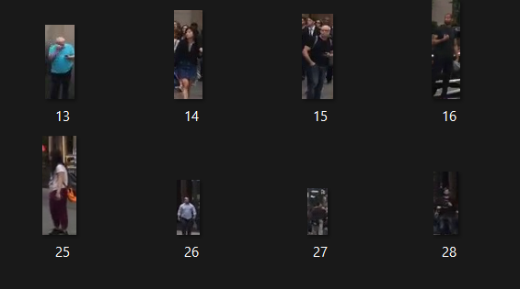
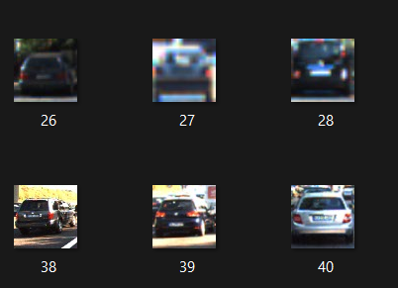
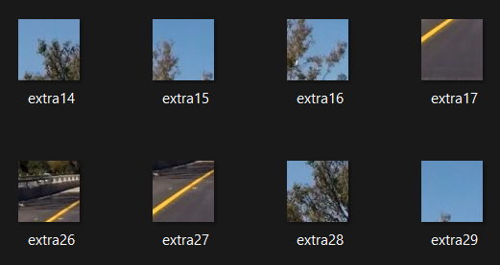
Implementation
Collect the images of the pedestrians and the objects as a dataset from Kaggle.
Classify the images into positive and negative dataset.
The positive images consists of the objects and the pedestrian images(represented as p) and the Negative images consists of the background images (represented as n).
Positive Images of Pedestrians
Positive Images of Vehicles
Negative Images of
Vehicles and Pedestrians.

Slide 17
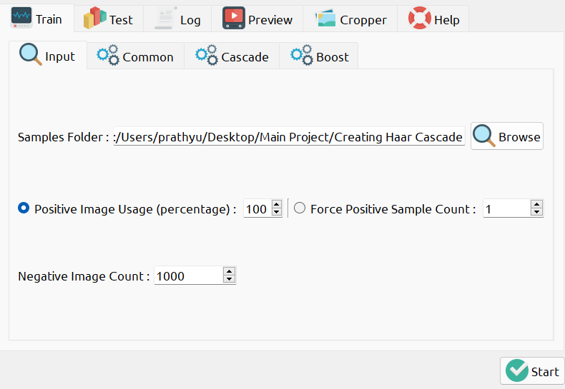
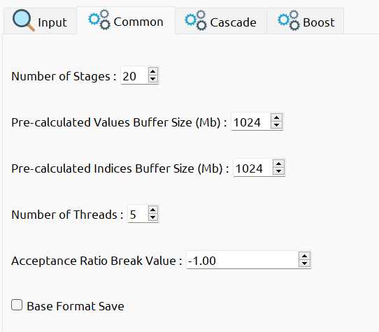
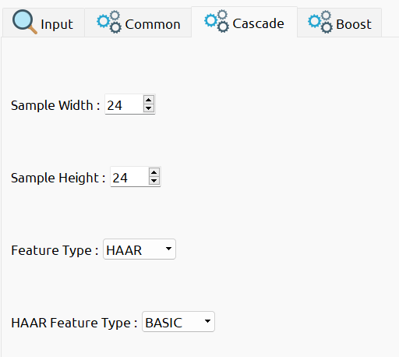
Implementation
Now train the Images using Cascade Classifier GUI by setting the number of stages including height and width.

Slide 18
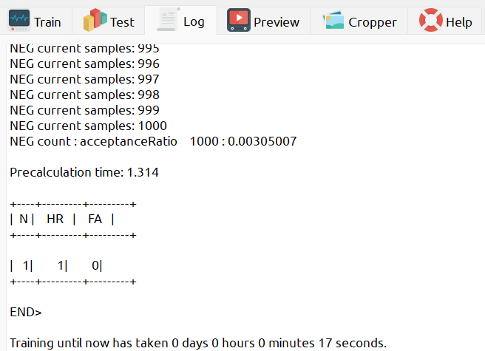
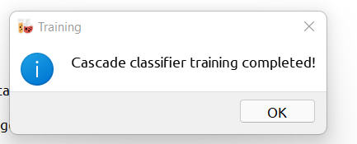
Implementation
Now start training the images.
The Training images result as an XML file which is used as a classifier.

Slide 19

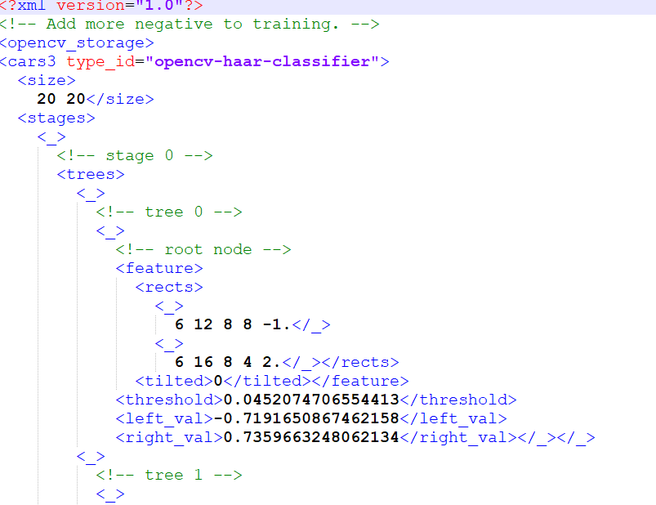
Implementation
The classifier File which contains XML File
Created XML File after training.

Slide 20
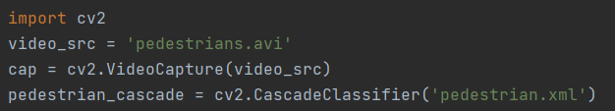
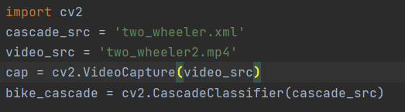
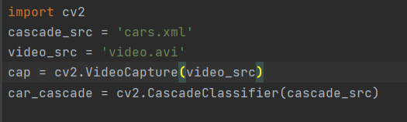
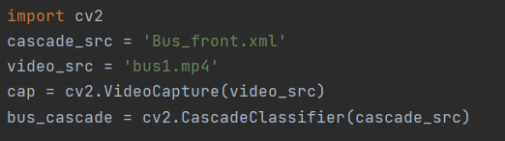
Implementation
The different kinds of XML Files are imported accordingly including the testing videos.
For Pedestrian Detection:
For Bike Detection:
For Car Detection:
For Bus Detection:

Slide 21
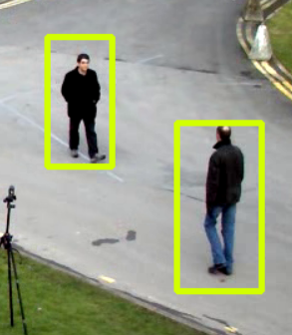
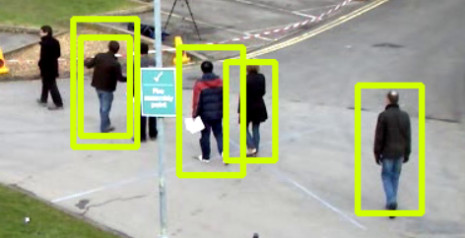
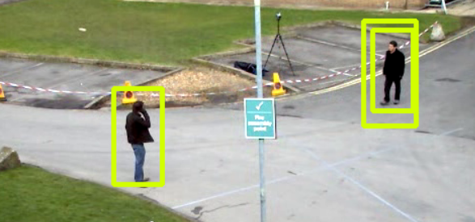
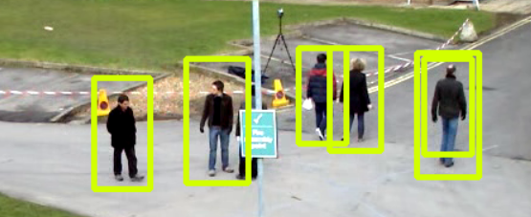
Execution
Detecting Pedestrians:

Slide 22
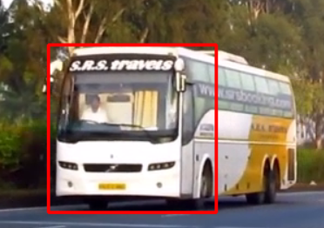
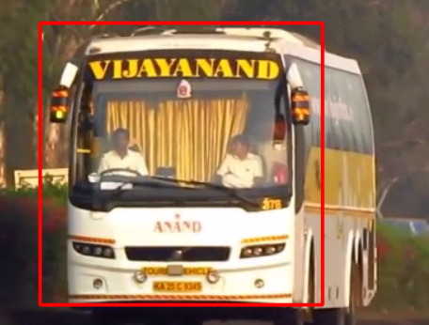
Execution
Detecting Bus:

Slide 23
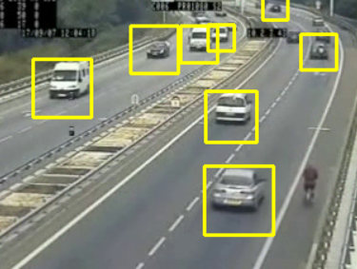
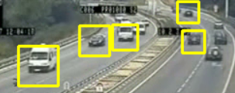
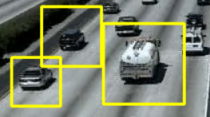
Execution
Detecting Car:

Slide 24
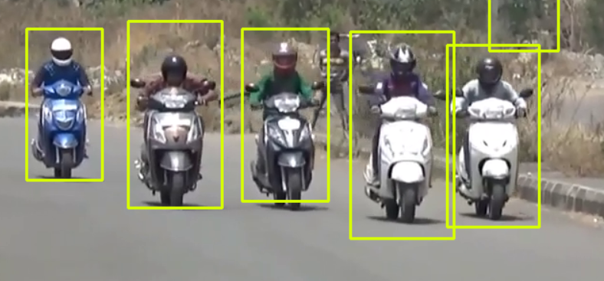
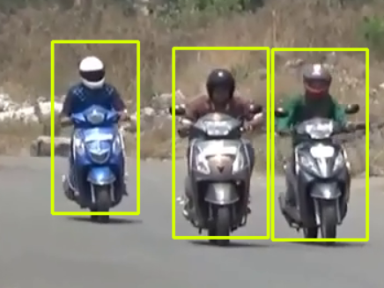
Execution
Detecting Bike:

Slide 25
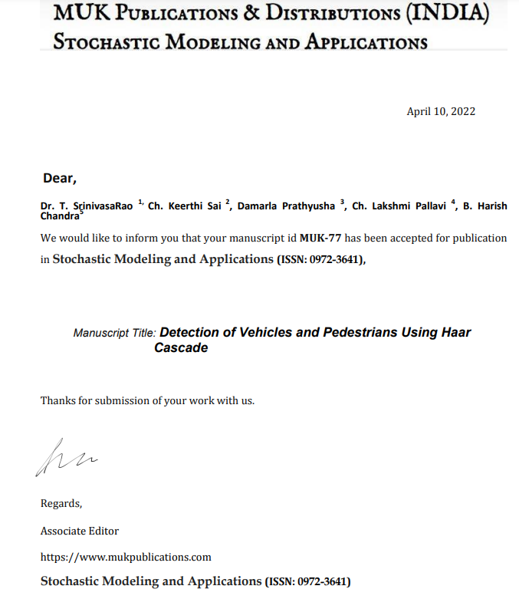
Journal
Paper got Accepted and Published in Stochastic Modeling and Applications Journal

Slide 26
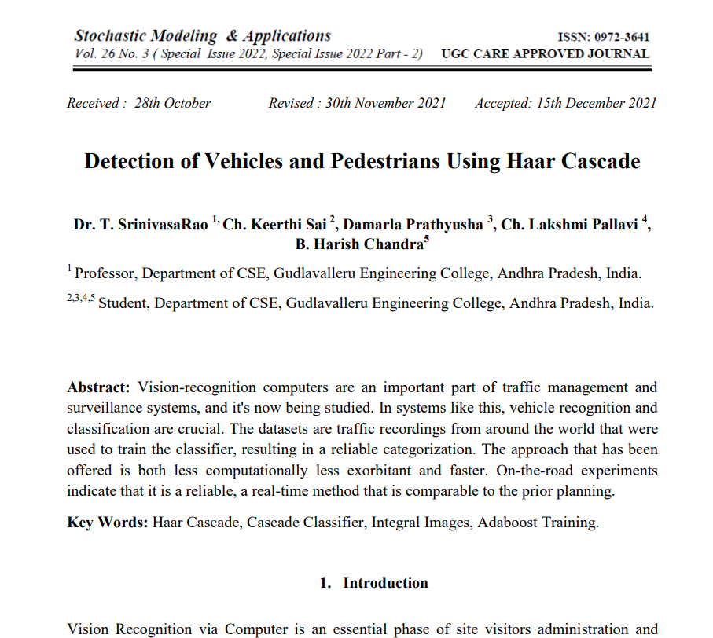
Journal
Paper got Accepted and Published in Stochastic Modeling and Applications Journal.

Slide 27


